Slide 1
Worksheets/slides to be printed
7. Area of composite shapes

Slide 2
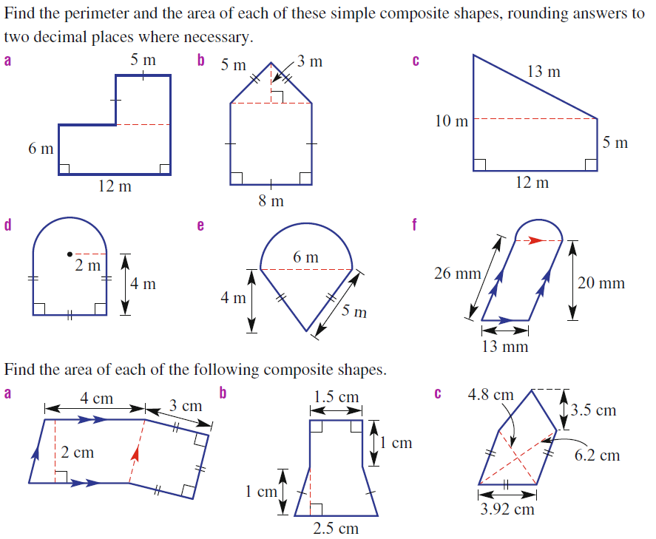
You Do

Slide 3
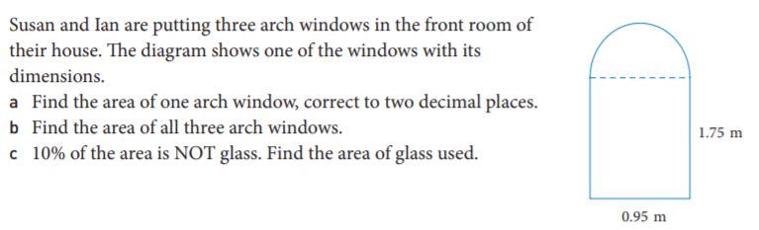
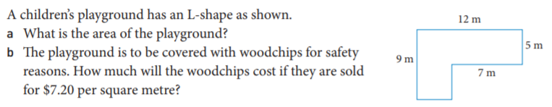
Worded questions
1.
2.

Slide 4
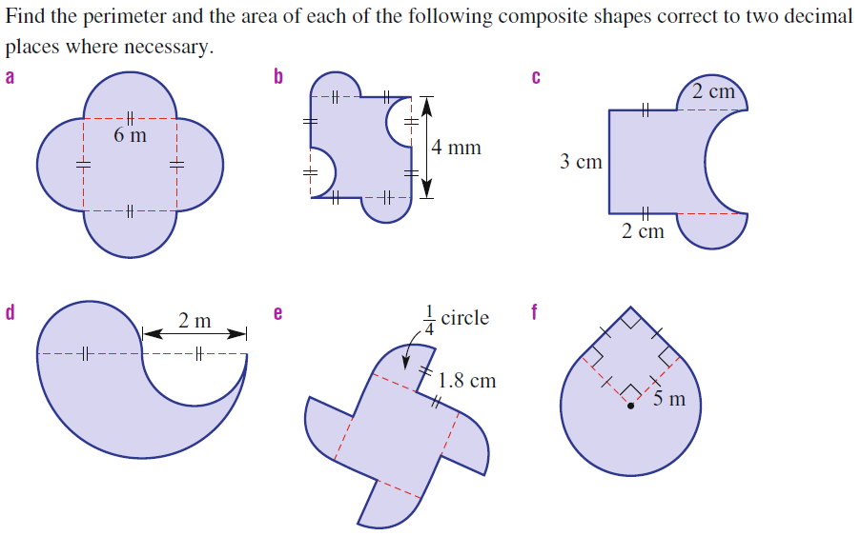
You do

